Slide 1
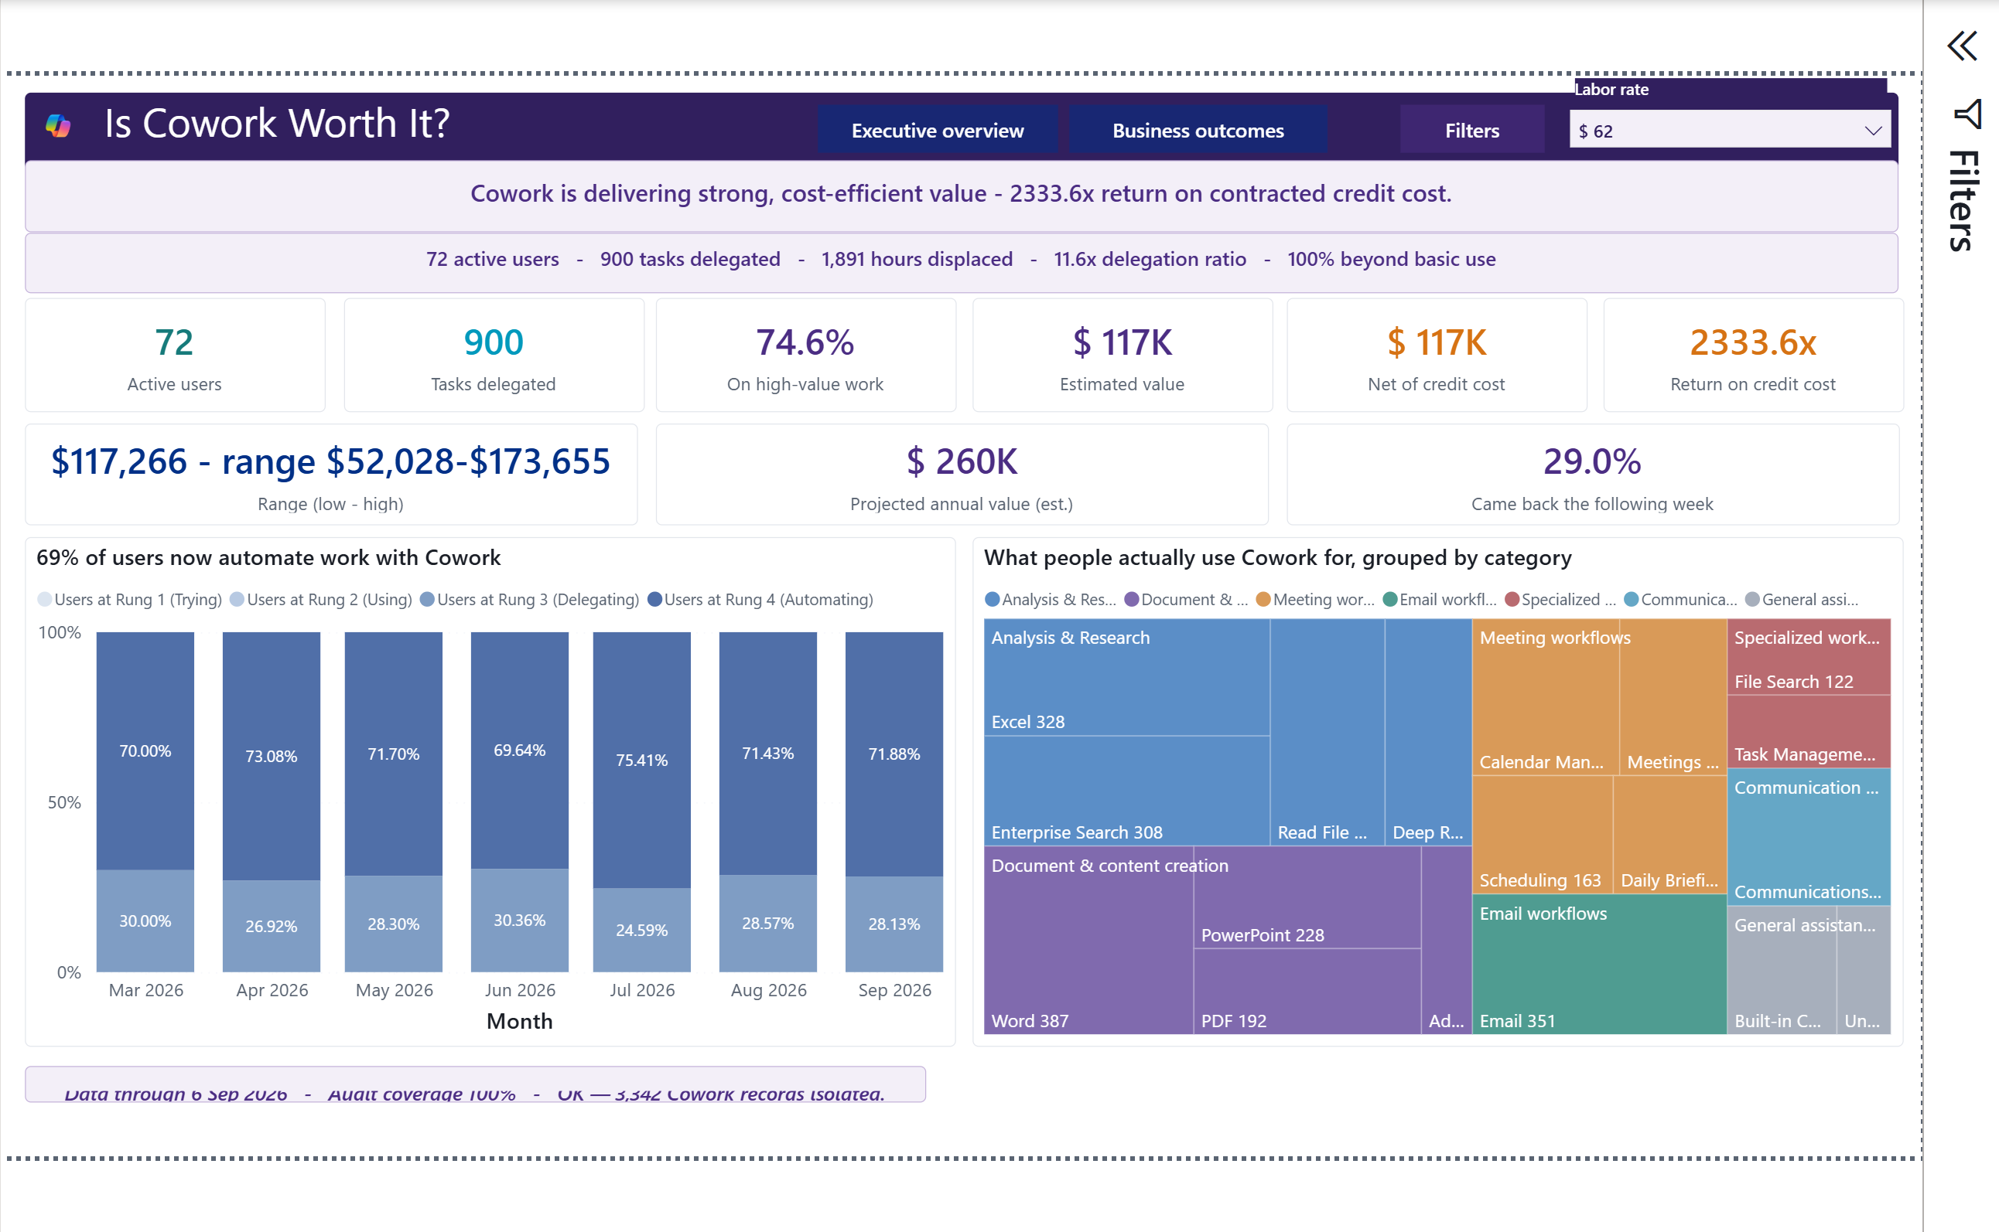
VERSION 1.0 • IN TESTING
Cowork
Value Intelligence
Interpretation Storyboard
A page-by-page guide to adoption, delegated work, modeled value, consumption, and evidence-aware action.
Actual Power BI capture • deterministic synthetic data
Observed signals. Transparent assumptions. Defensible decisions.
Fabricated sample data • @example.com identities

Slide 2
Use the same four-question reading path
Interpretation before action
1
PURPOSE
2
READ
Start with the business decision the page is designed to support.
Confirm the filters, reporting period, source status, and metric grain.
3
INTERPRET
4
ACTION
Separate observed evidence from modeled or allocated values.
Corroborate the source record and document the owner before acting.
llorenz28/cowork-value-intelligence
Version 1.0 | In Testing | Fabricated sample data

Slide 3
Different evidence requires different wording
Confidence ladder
OBSERVED
Direct source count
The connected export contains…
DERIVED
Arithmetic over observed fields
The report calculates…
MODELED
Observed activity plus assumptions
Under the selected assumptions…
ALLOCATED
A total distributed without source metering
The modeled allocation suggests…
UNAVAILABLE
A required dependency is absent
This cannot be calculated yet.
llorenz28/cowork-value-intelligence
Version 1.0 | In Testing | Fabricated sample data

Slide 4
Four source contracts, one evidence chain
Customer-owned inputs
1
2
3
4
Purview audit
Cowork usage
Organization
Consumption
Threads, timestamps, skills, resources, optional model attribution
Reported tasks, scheduled split, active days, reconciliation
Department, business unit, manager, role, geography
Credit allowance, credits used, sessions, and recency
The usage export is aggregate evidence. It must never manufacture an event timeline.
llorenz28/cowork-value-intelligence
Version 1.0 | In Testing | Fabricated sample data

Slide 5
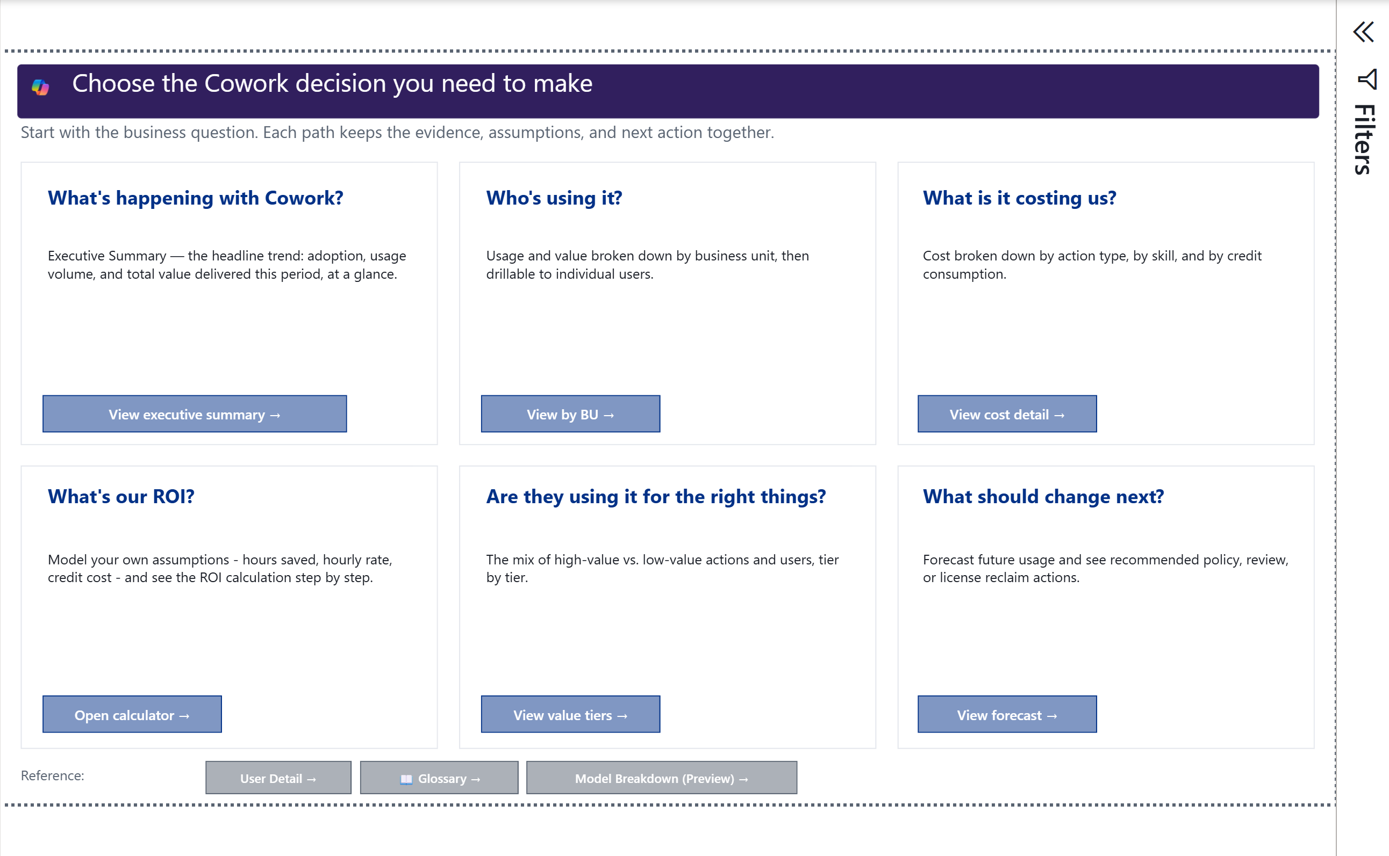
Start Here
1 of 13 report pages
P
PURPOSE
Route each business question to the page with the right evidence.
R
READ
Choose the decision first: adoption, audience, cost, ROI, work mix, or next action.
I
INTERPRET
A page can be useful even when optional billing or organization inputs are absent.
Actual Power BI capture • deterministic synthetic data
A
ACTION
Open one path and verify its data-status notes before quoting a number.
llorenz28/cowork-value-intelligence
Version 1.0 | In Testing | Fabricated sample data

Slide 6
Executive Summary
2 of 13 report pages
P
PURPOSE
Summarize adoption, delegated work, modeled value, cost, and work mix.
R
READ
Read observed users and tasks before scenario-based value and ROI.
I
INTERPRET
A favorable ROI is conditional on labor rate, billing model, and credit price.
Actual Power BI capture • deterministic synthetic data
A
ACTION
Confirm reconciliation and Finance-approved inputs before sharing the headline.
llorenz28/cowork-value-intelligence
Version 1.0 | In Testing | Fabricated sample data

Slide 7
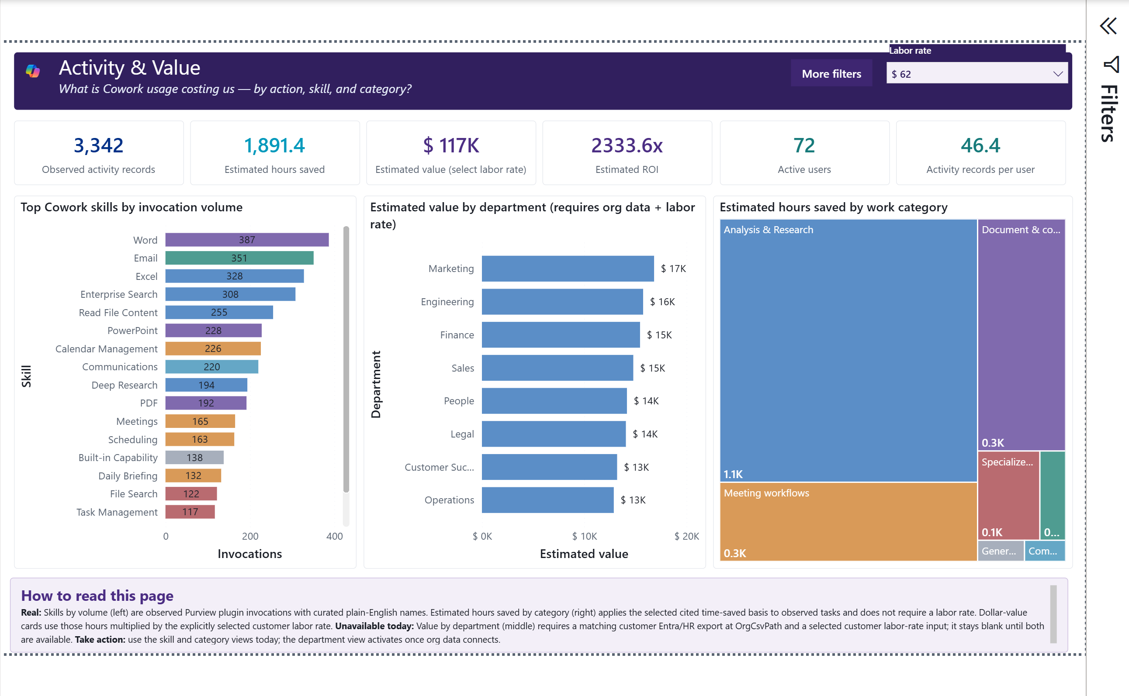
Activity & Value
3 of 13 report pages
P
PURPOSE
Show which skills and departments contribute to modeled value.
R
READ
Skill invocations are observed; hours and dollars combine activity with assumptions.
I
INTERPRET
High volume shows embedded workflows; high value reflects the selected time-saving assumptions.
Actual Power BI capture • deterministic synthetic data
A
ACTION
Validate organization mappings and compare low, mid, and high labor-rate scenarios.
llorenz28/cowork-value-intelligence
Version 1.0 | In Testing | Fabricated sample data

Slide 8
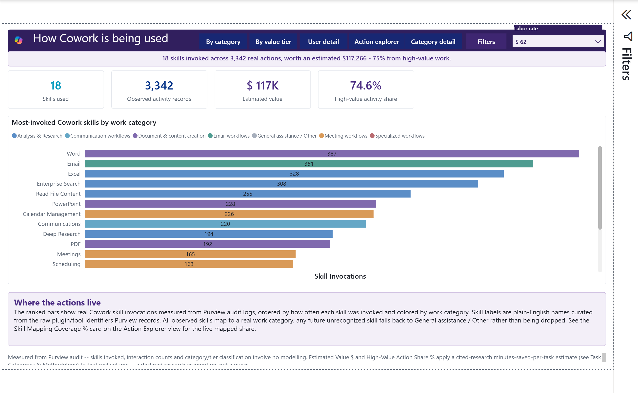
Actions
4 of 13 report pages
P
PURPOSE
Explain what Cowork did by skill, category, and value tier.
R
READ
Skill activity and category value use different grains; do not sum repeated category value across skills.
I
INTERPRET
A broader skill mix can signal workflow maturity, but unmapped tools need review.
Actual Power BI capture • deterministic synthetic data
A
ACTION
Review unmapped skills first, then use category and tier views for rollups.
llorenz28/cowork-value-intelligence
Version 1.0 | In Testing | Fabricated sample data

Slide 9
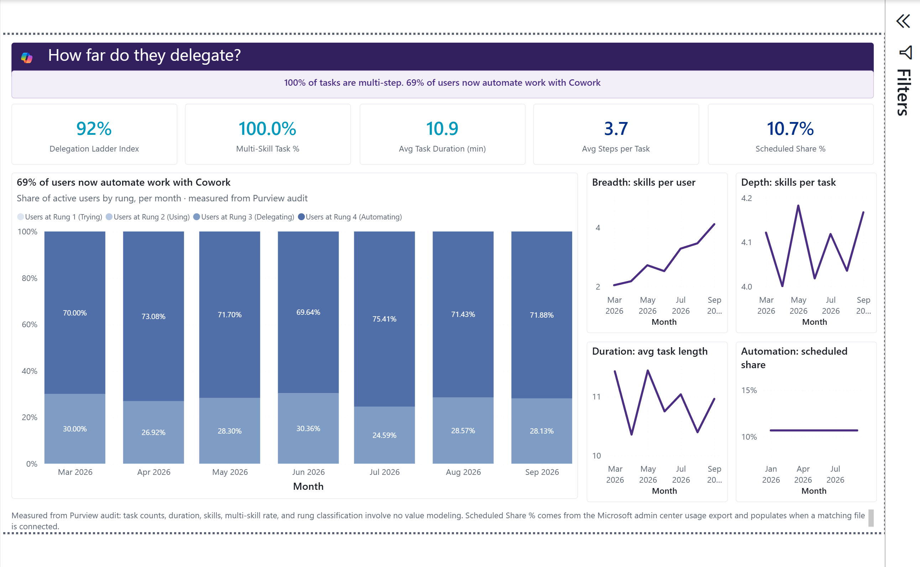
How Far They Delegate
5 of 13 report pages
P
PURPOSE
Describe task depth, elapsed duration, steps, and skill chaining.
R
READ
Duration is first-to-last audit event time, not measured human attention.
I
INTERPRET
Longer or multi-skill threads can show complex delegation or process friction.
Actual Power BI capture • deterministic synthetic data
A
ACTION
Sample the underlying thread and confirm business purpose before calling it autonomous.
llorenz28/cowork-value-intelligence
Version 1.0 | In Testing | Fabricated sample data

Slide 10
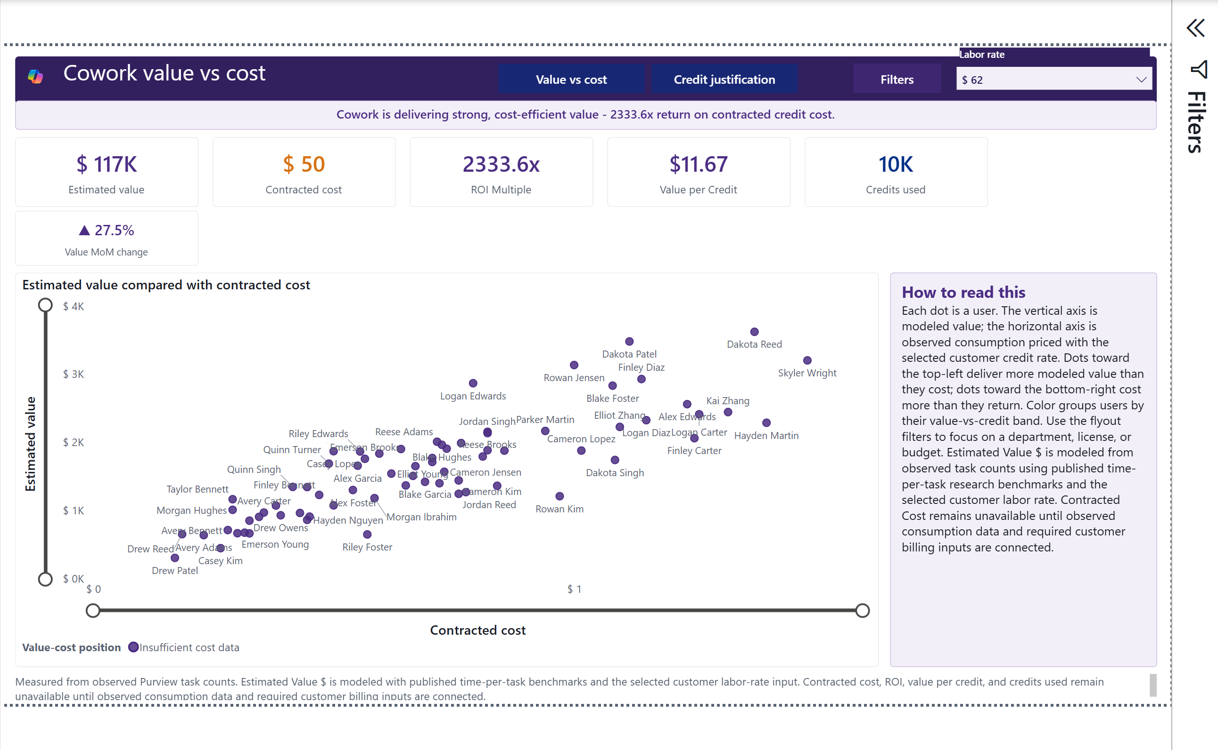
Value vs Cost
6 of 13 report pages
P
PURPOSE
Compare modeled value with customer-priced observed consumption.
R
READ
Value is modeled; credits are observed; cost and ROI require selected contract inputs.
I
INTERPRET
Position above the diagonal is favorable only under the current assumptions.
Actual Power BI capture • deterministic synthetic data
A
ACTION
Re-run with Finance-approved terms and inspect user-level outliers.
llorenz28/cowork-value-intelligence
Version 1.0 | In Testing | Fabricated sample data

Slide 11
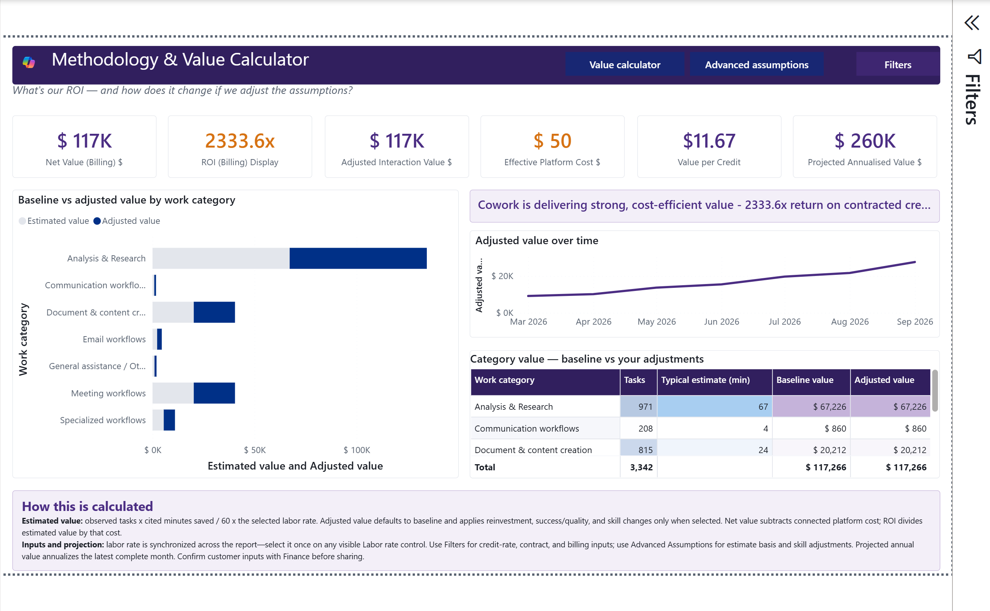
Methodology & Value Calculator
7 of 13 report pages
P
PURPOSE
Make the value formula and every adjustable input visible.
R
READ
Observed tasks × typical minutes ÷ 60 × labor rate produces baseline value.
I
INTERPRET
The low-to-high range is assumption sensitivity, not statistical confidence.
Actual Power BI capture • deterministic synthetic data
A
ACTION
Export the assumptions, period, filters, and formula with every value result.
llorenz28/cowork-value-intelligence
Version 1.0 | In Testing | Fabricated sample data

Slide 12
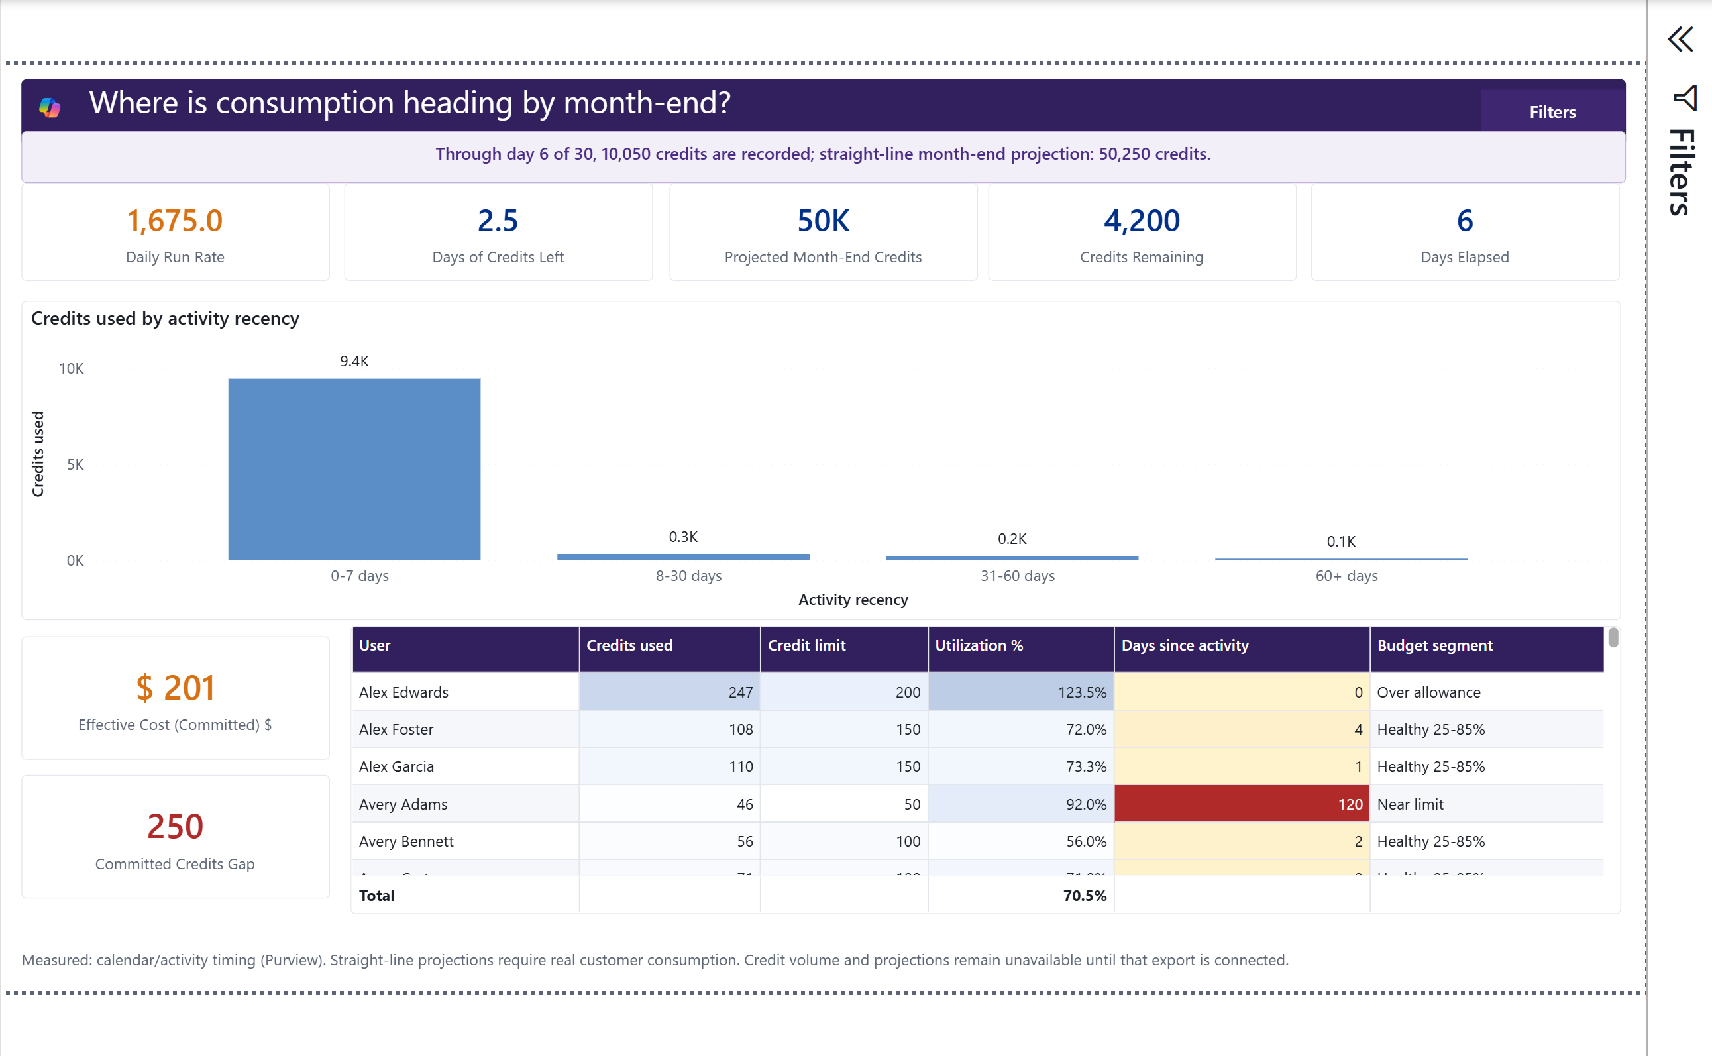
Consumption & Forecast
8 of 13 report pages
P
PURPOSE
Estimate month-end credit consumption and commitment fit.
R
READ
The projection is a straight line from observed credits and elapsed days.
I
INTERPRET
A positive gap suggests overage; a negative gap suggests under-utilization.
Actual Power BI capture • deterministic synthetic data
A
ACTION
Check freshness and seasonality before changing a commitment.
llorenz28/cowork-value-intelligence
Version 1.0 | In Testing | Fabricated sample data

Slide 13
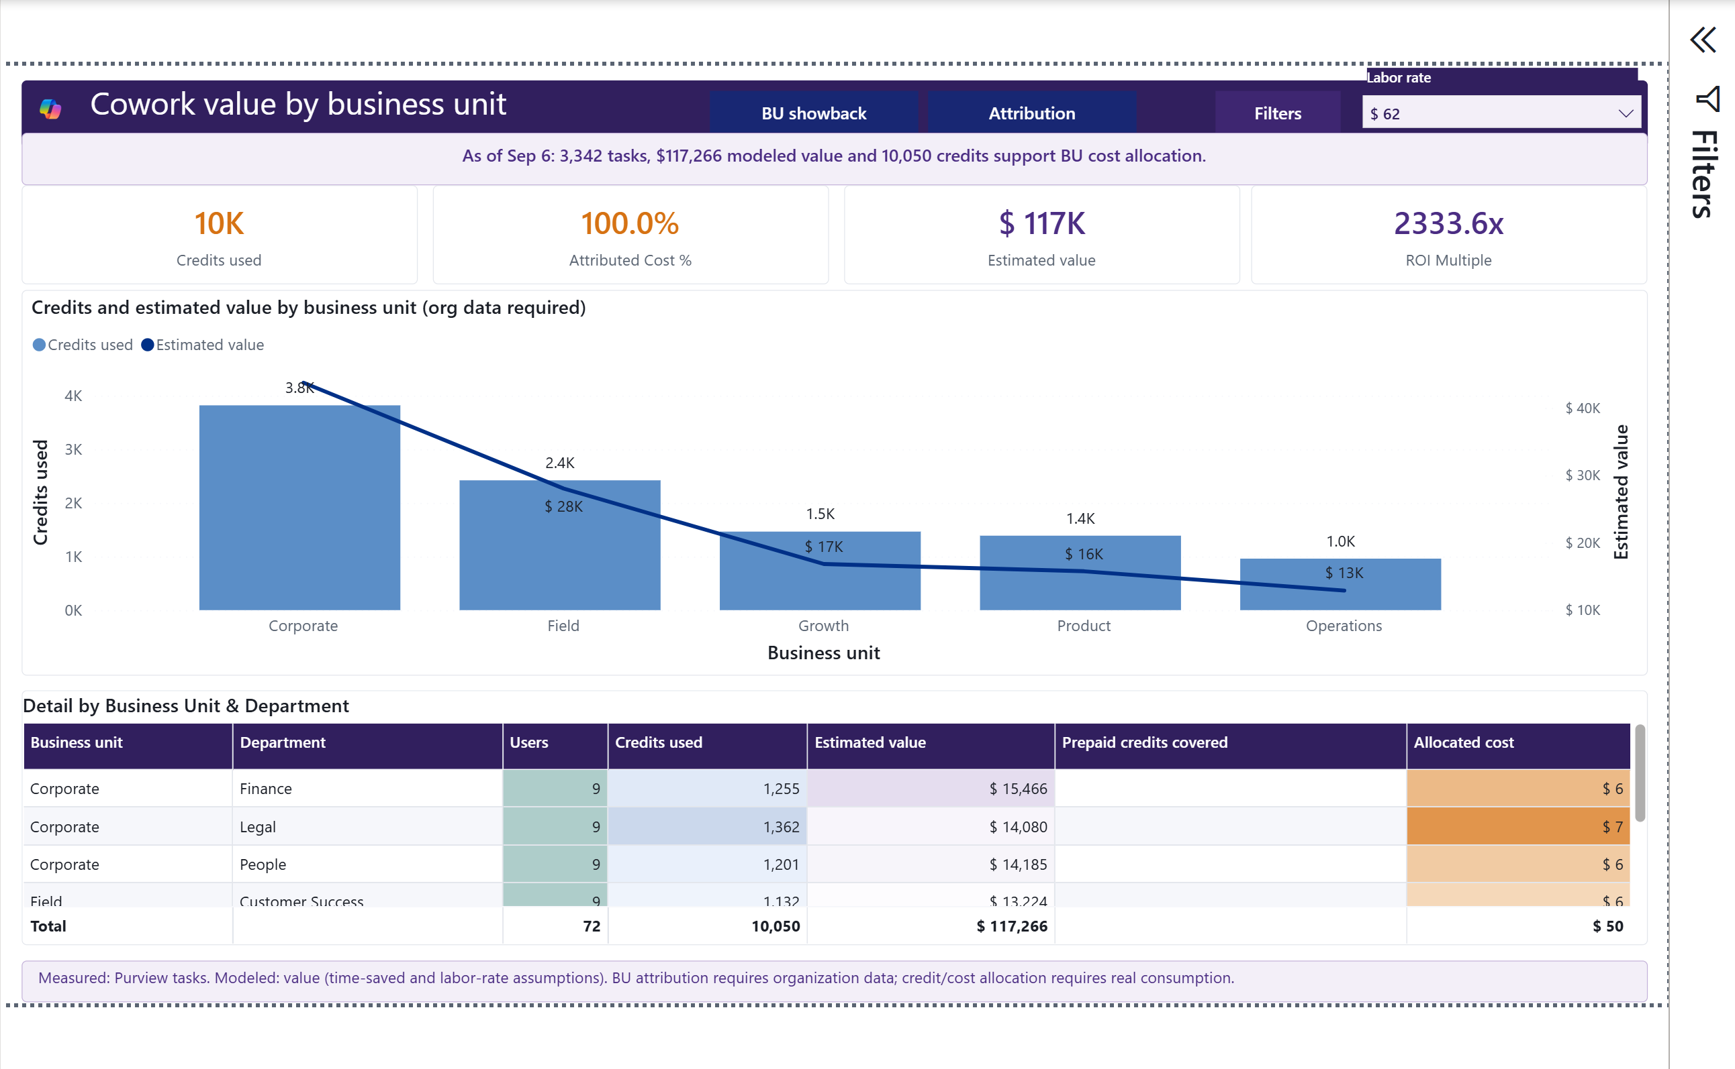
BU Showback
9 of 13 report pages
P
PURPOSE
Attribute consumption and modeled value to business units.
R
READ
Organization comes from the customer export; allocated cost follows the selected policy.
I
INTERPRET
Allocation is not invoice metering and should not be treated as a chargeback by default.
Actual Power BI capture • deterministic synthetic data
A
ACTION
Confirm cost-center ownership and allocation policy with Finance.
llorenz28/cowork-value-intelligence
Version 1.0 | In Testing | Fabricated sample data

Slide 14
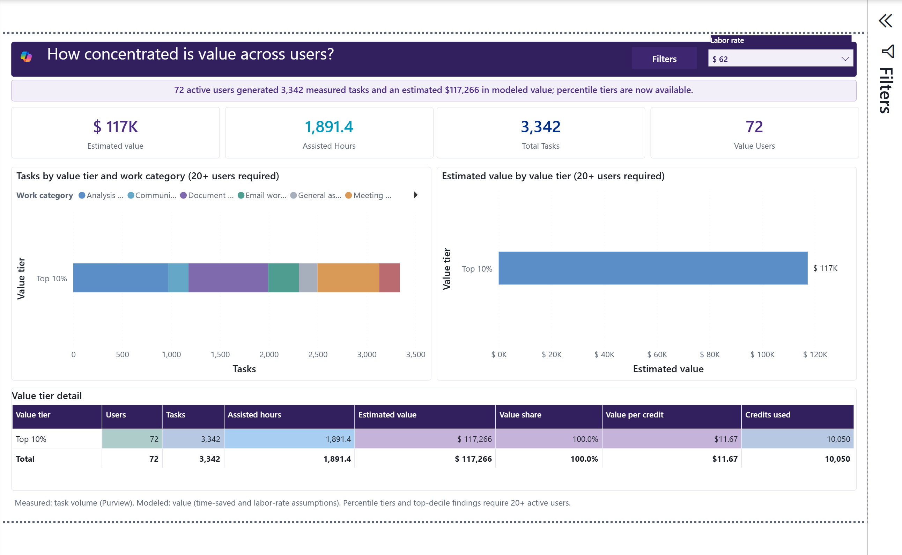
Value by User Tier
10 of 13 report pages
P
PURPOSE
Show how concentrated tasks and modeled value are across users.
R
READ
Percentile tiers require at least 20 users; the synthetic sample supports the split.
I
INTERPRET
Concentration can identify champions, dependency, or uneven enablement.
Actual Power BI capture • deterministic synthetic data
A
ACTION
Pair tiers with business unit and work category before targeting action.
llorenz28/cowork-value-intelligence
Version 1.0 | In Testing | Fabricated sample data

Slide 15
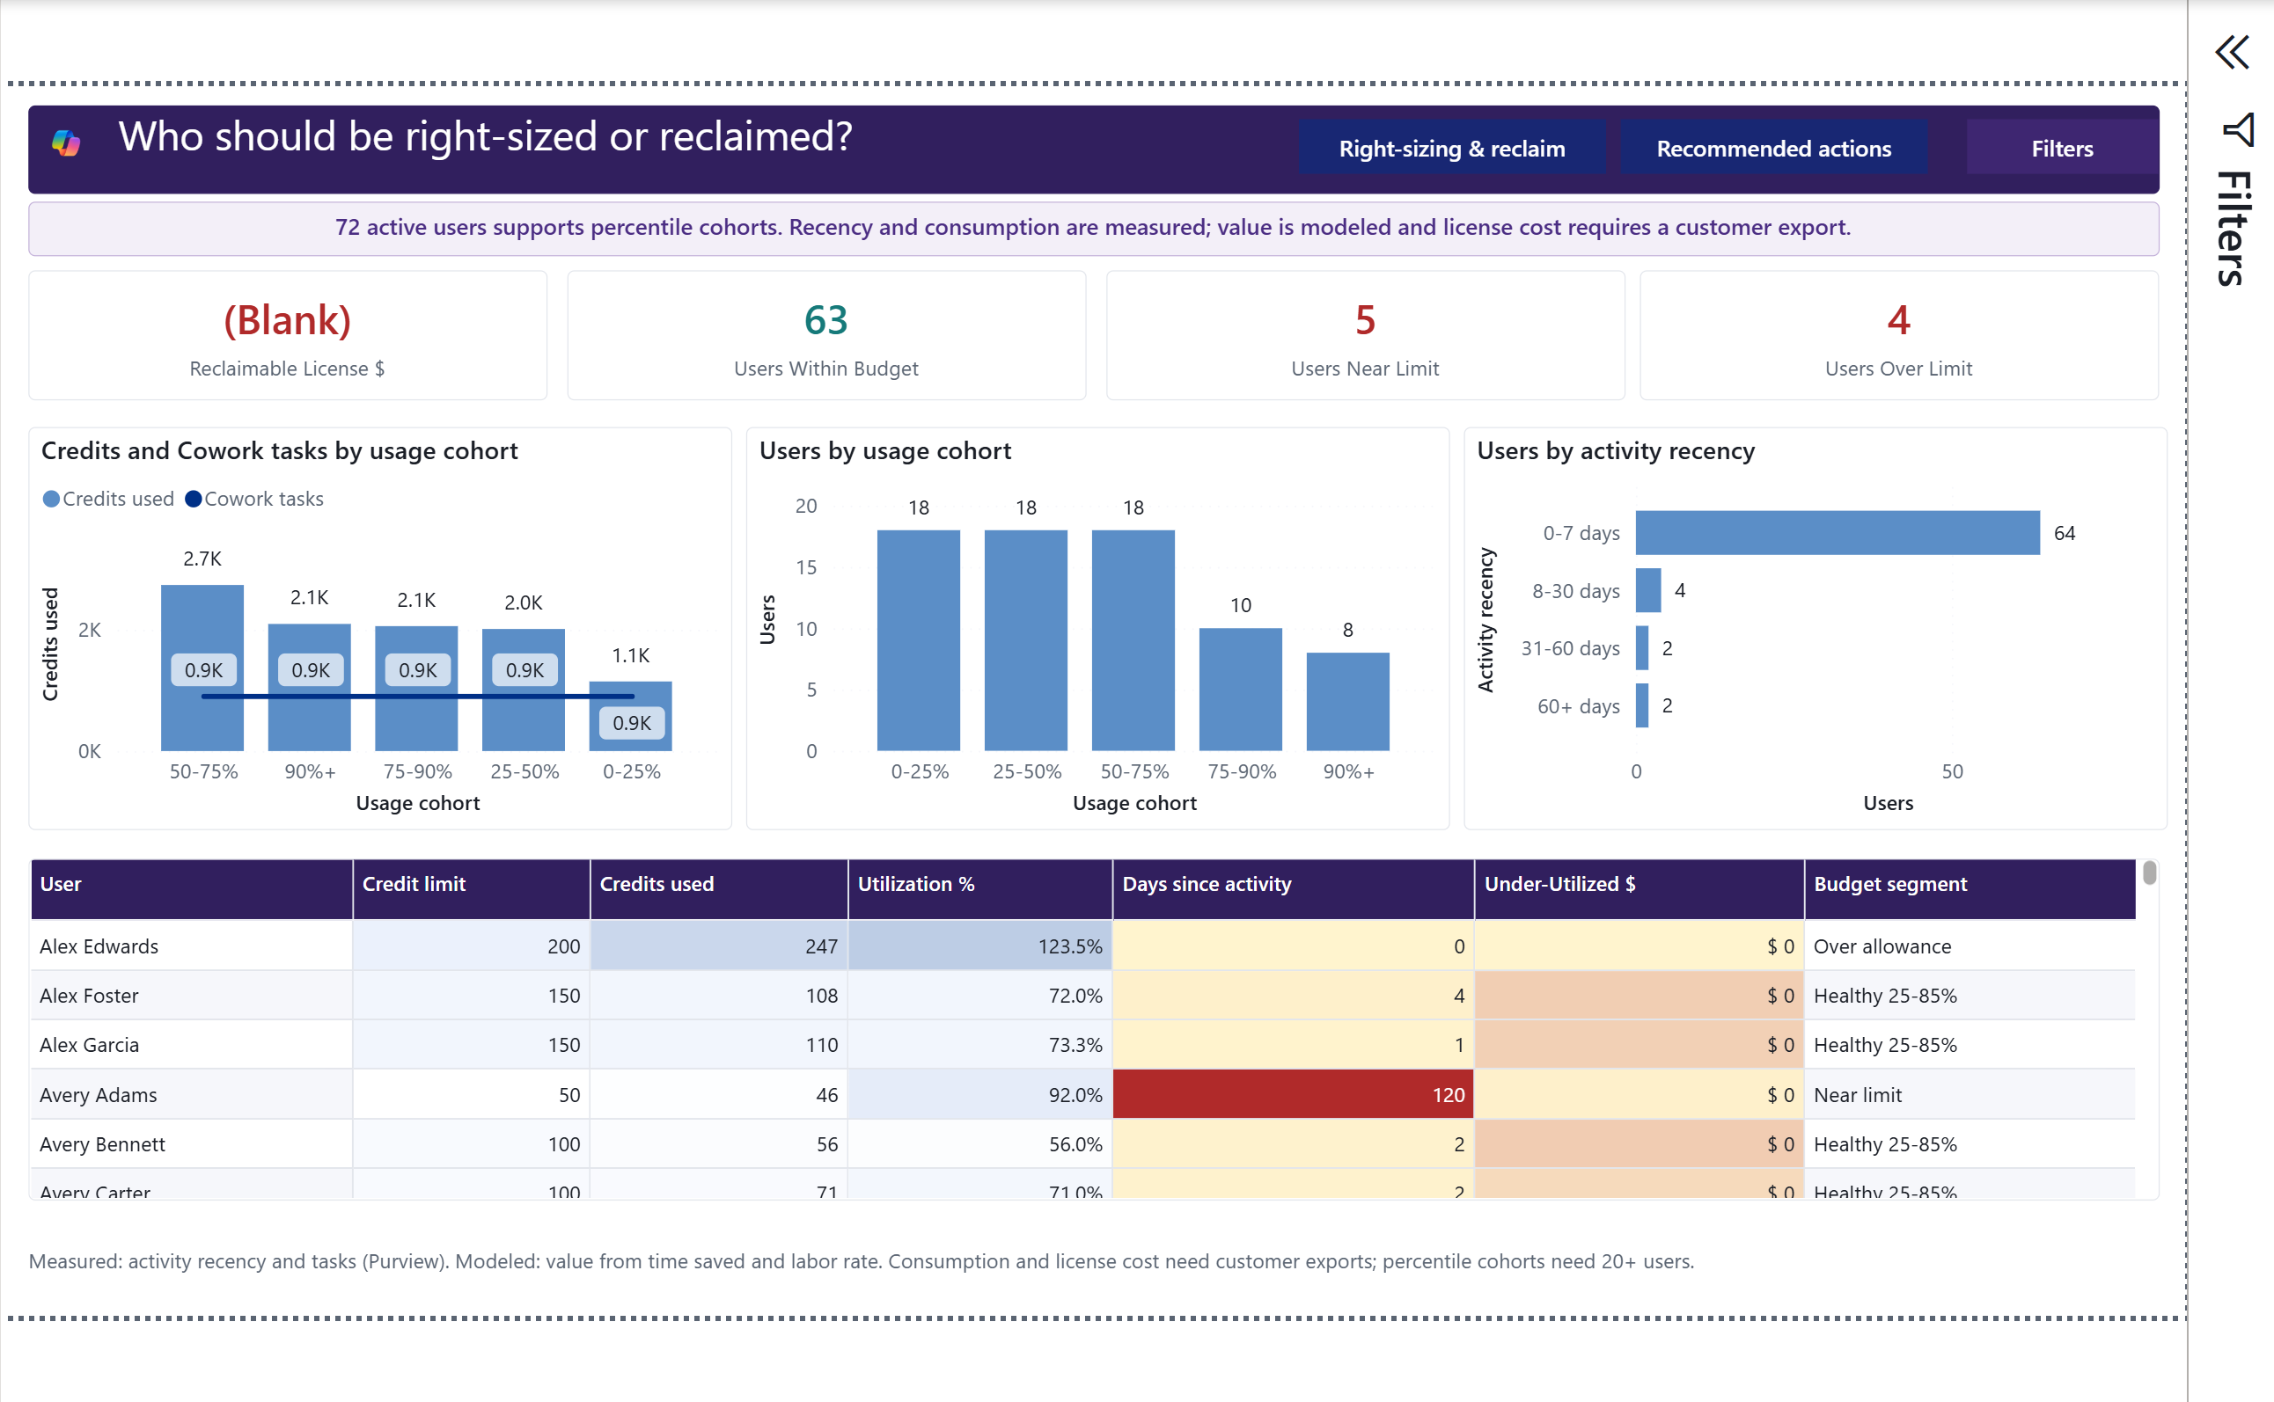
Right-Sizing & Reclaim
11 of 13 report pages
P
PURPOSE
Identify utilization, recency, and budget exceptions.
R
READ
Near-limit and over-limit use observed consumption; reclaim dollars need license price.
I
INTERPRET
Low activity is a follow-up signal, not an automatic removal decision.
EXPECTED BLANK • LICENSE PRICE REQUIRED
A
ACTION
Confirm role, leave, seasonality, and license terms before changing access.
llorenz28/cowork-value-intelligence
Version 1.0 | In Testing | Fabricated sample data

Slide 16
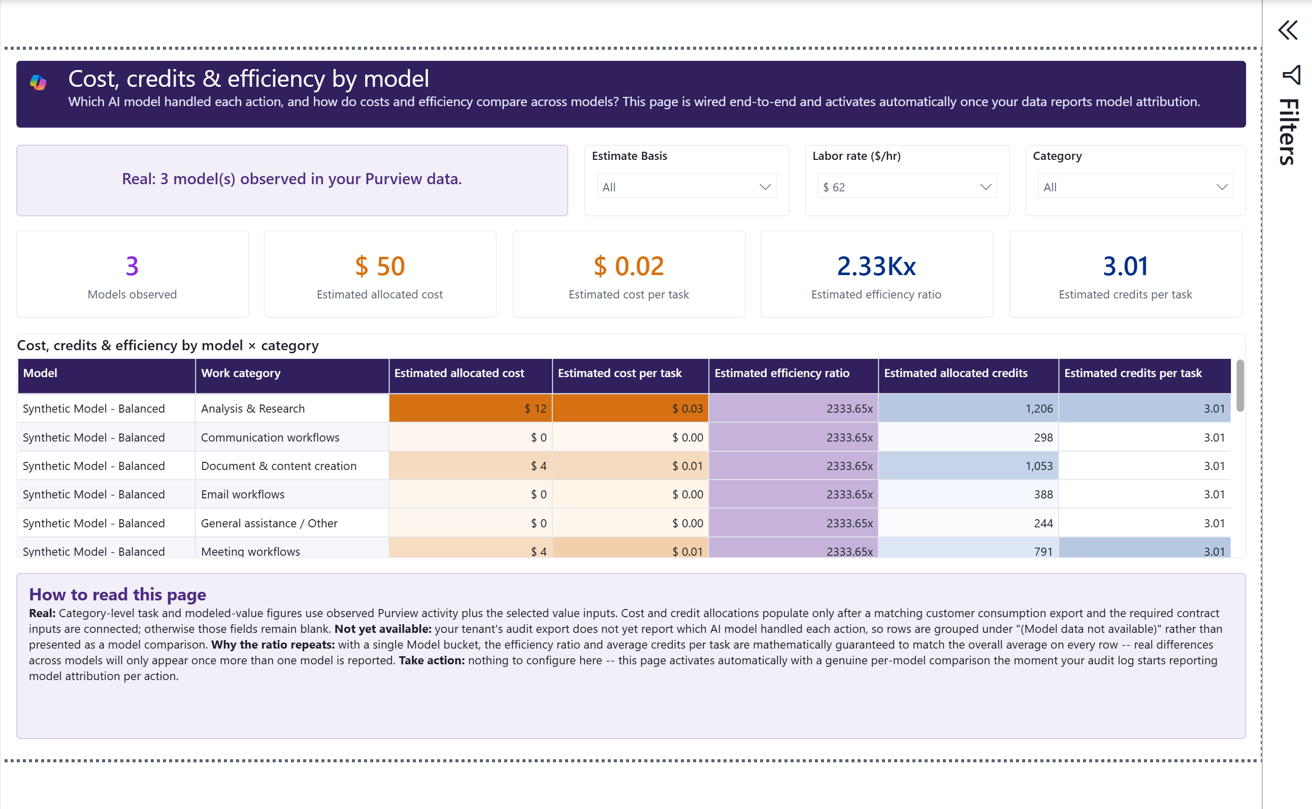
Model & LLM Breakdown
12 of 13 report pages
P
PURPOSE
Show source-attributed model activity and modeled efficiency by category.
R
READ
Model labels are observed; current cost and credits are allocated estimates.
I
INTERPRET
The page cannot yet prove that one model is cheaper without model-specific metering.
Actual Power BI capture • deterministic synthetic data
A
ACTION
Add compatible per-model credit and duration evidence before recommending a model.
llorenz28/cowork-value-intelligence
Version 1.0 | In Testing | Fabricated sample data

Slide 17
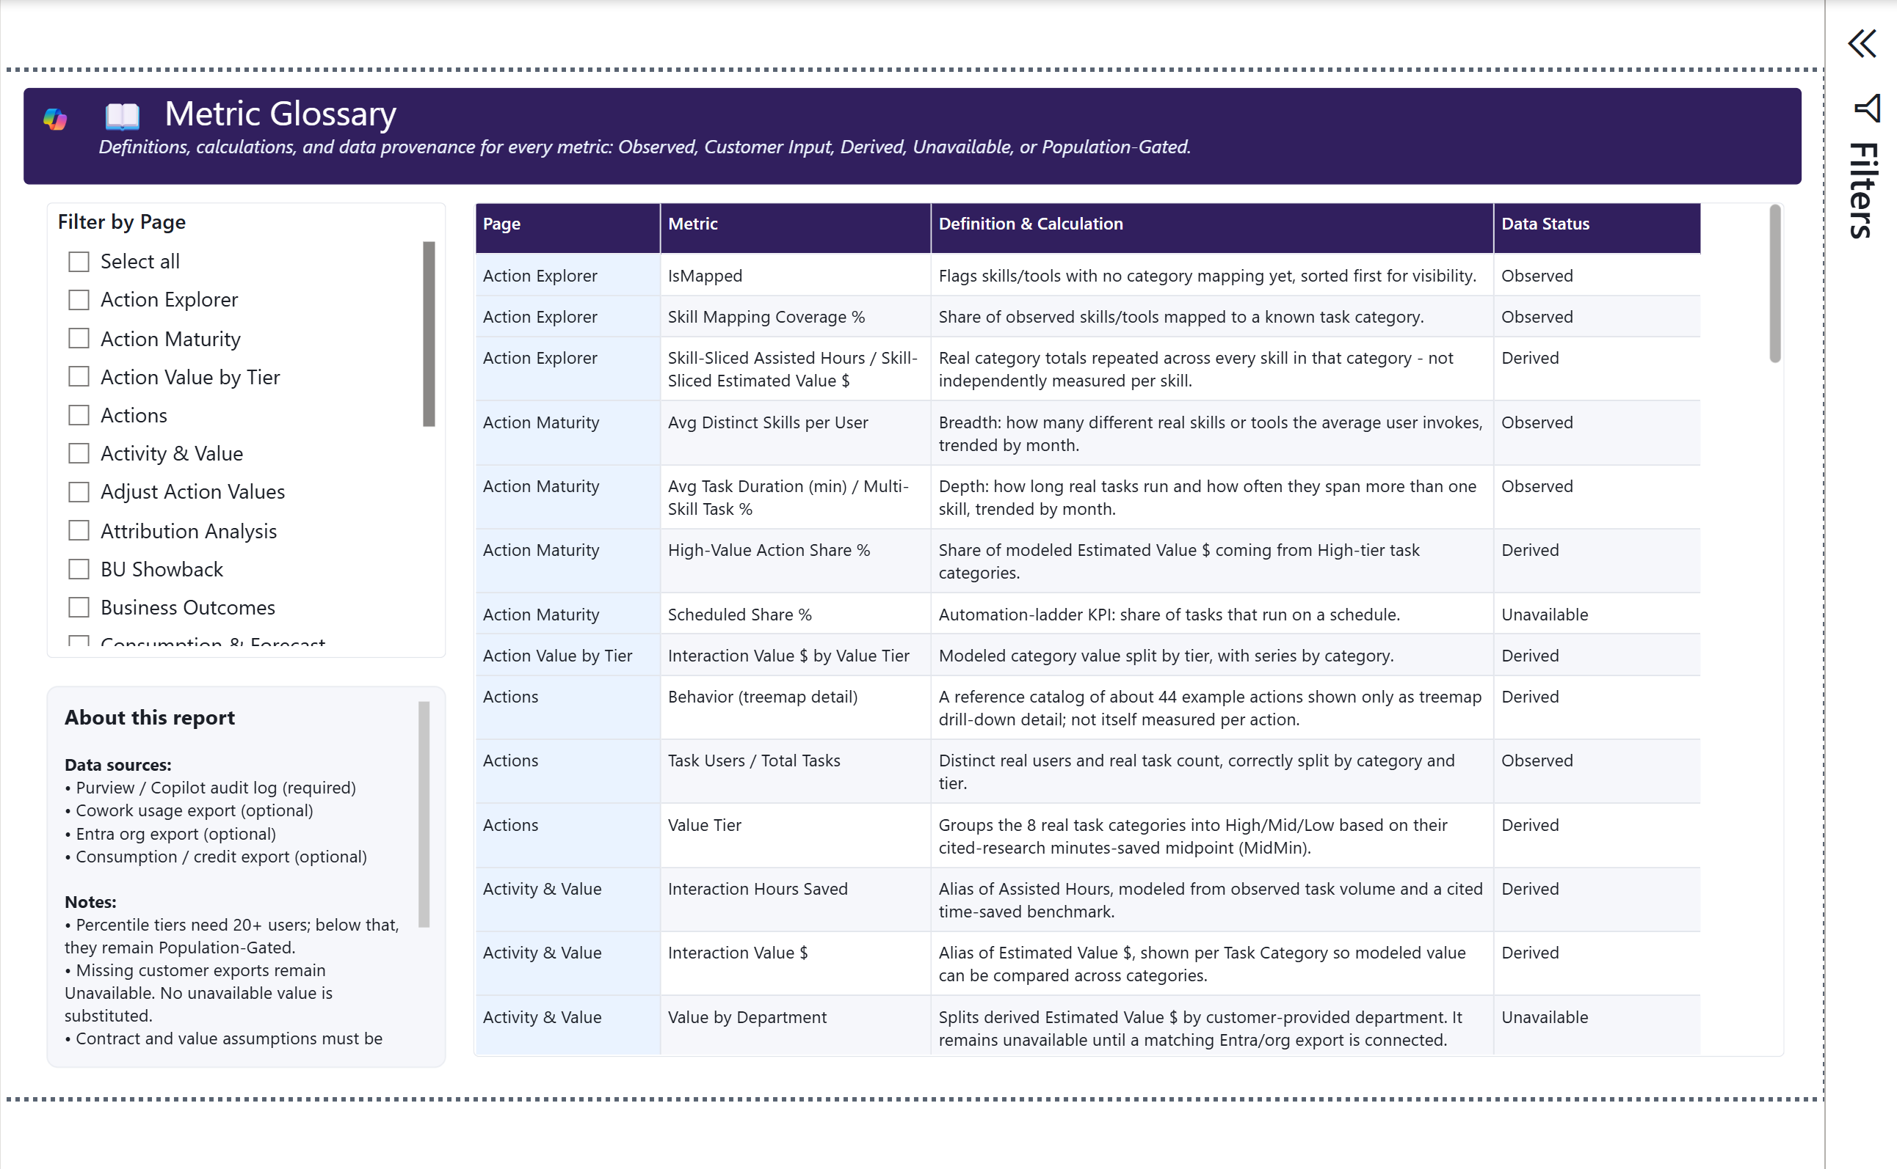
Glossary
13 of 13 report pages
P
PURPOSE
Define each metric and disclose its ownership and availability.
R
READ
Use the definition and data status together; unavailable does not mean zero.
I
INTERPRET
Modeled and allocated metrics need their assumptions when shared.
Actual Power BI capture • deterministic synthetic data
A
ACTION
Copy the definition, period, filters, and confidence label into decision records.
llorenz28/cowork-value-intelligence
Version 1.0 | In Testing | Fabricated sample data

